Slide 1
Digital Learning – Taking a Collegiate Approach
Wednesday 24th February 2021
Mairi Green
Primary Teacher, West Lothian
EIS Learning Representative

Slide 2
Influences
Pupils
Teachers
All Staff
Leadership Team
Parents
Council
Scottish Government
Academics
Unions

Slide 3
Gathering Views
Parent survey (school, council)
Parent Council (virtual meetings)
Parent drop in sessions
Pupil Survey (school and council)
Staff views (school session, staff Teams pages, regular contact)
Leadership Team discussions (CAT sessions)
Digital Leaders (CAT sessions and individual support)
Council Feedback
Professional Reading
Union meetings

Slide 4
Why?
Create a shared vision and understanding
Ensure equity across stages/classes/subjects
Address issues and make changes
Reflect on strengths
To debrief and reflect
Make decisions about how to utilise online learning opportunities when returning to school
Identify opportunities to manage workload

Slide 5
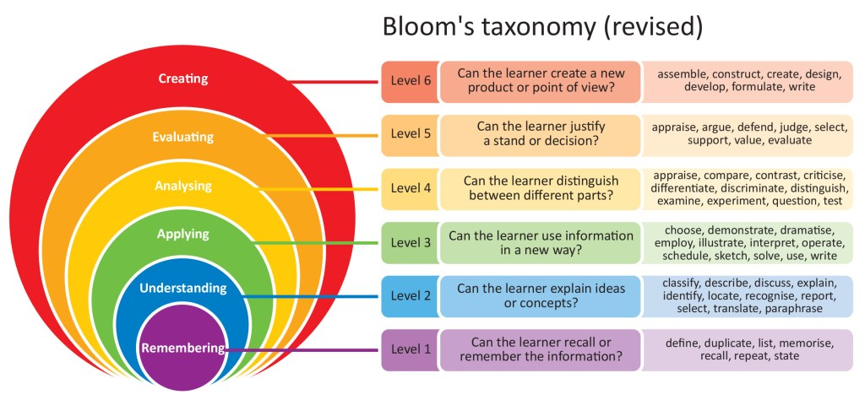
Things to Consider
Learner at the Centre
When planning for e-Learning make sure learning is as easy as possible for your learners and also for you as the educator. In e-Learning, teachers are the facilitators of learning – there is shared balance of power, communication and dialogue that allows the learners to learn through their own experiences and come to their own conclusions. (Socrates, Bloom’s Taxonomy)

Slide 6
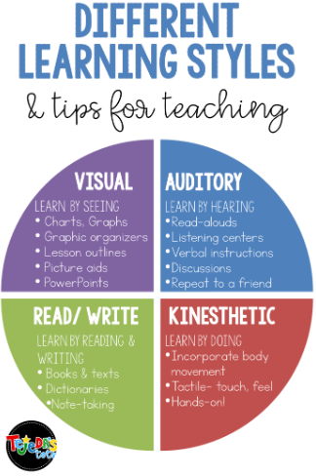
Consider different learning styles when planning online experiences.
Think about how learning can be accessible to all.

Slide 7
Copyright
Please be mindful of copyright laws. You can find out more here: https://www.mygov.scot/copyright/
Creative Commons is a site where you can find images that have been shared for public use. You still need to credit images.
https://creativecommons.org/

Slide 8
Our Strengths and Development Needs
Think about the digital skills you developed during lockdown.
Consider…
What you can do now that you couldn’t before
Things that your pupils enjoyed
A success that you had
Anything else you want to share

Slide 9
How are we going to take digital learning forward?
We want to move forward rather than going back….
How can we use digital learning to keep the momentum going?
Which aspects of Teams/Seesaw worked well, do we want to keep, what possibilities do we have to move forward?
How can we utilise online learning at school and home to add value to learning experiences?
How can we include all our learners?
How can we include parents? Meet the Teacher, Parents consultations, progress and feedback, curriculum afternoons?
How can we decrease cross-contamination?
How can we make our workload easier to manage?
How can we share experiences together with our physical divides?
How can we address issues like house points, assemblies, other things that we can no longer do?

Slide 10
Your Learning Needs
Thinking now about ideas shared, what are your learning needs?
Can these be addressed independently, with colleagues, at school level, at cluster level, at Council level, through the EIS, at National level?

Slide 11
Creating an Action Plan
From all of this information we were able to create an action plan to take online learning forward with a shared vision, providing equity and positive online learning experiences.
We were able to provide relevant training to staff to upskill them and increase their confidence.
We were able to address most difficulties experienced by families and prepare changes to make online learning easier.
We created plans for P1-3 and P4-7 for lockdowns, blended learning and at school scenarios.
Staff, parents and pupils felt prepared and able to manage much more easily during the second lockdown.
Our school had very high levels of engagement and very positive feedback from pupils, staff and parents.

Slide 12
Digital Learning – Taking a Collegiate Approach
Wednesday 24th February 2021
Mairi Green
Primary Teacher, West Lothian
EIS Learning Representative

